Slide 1
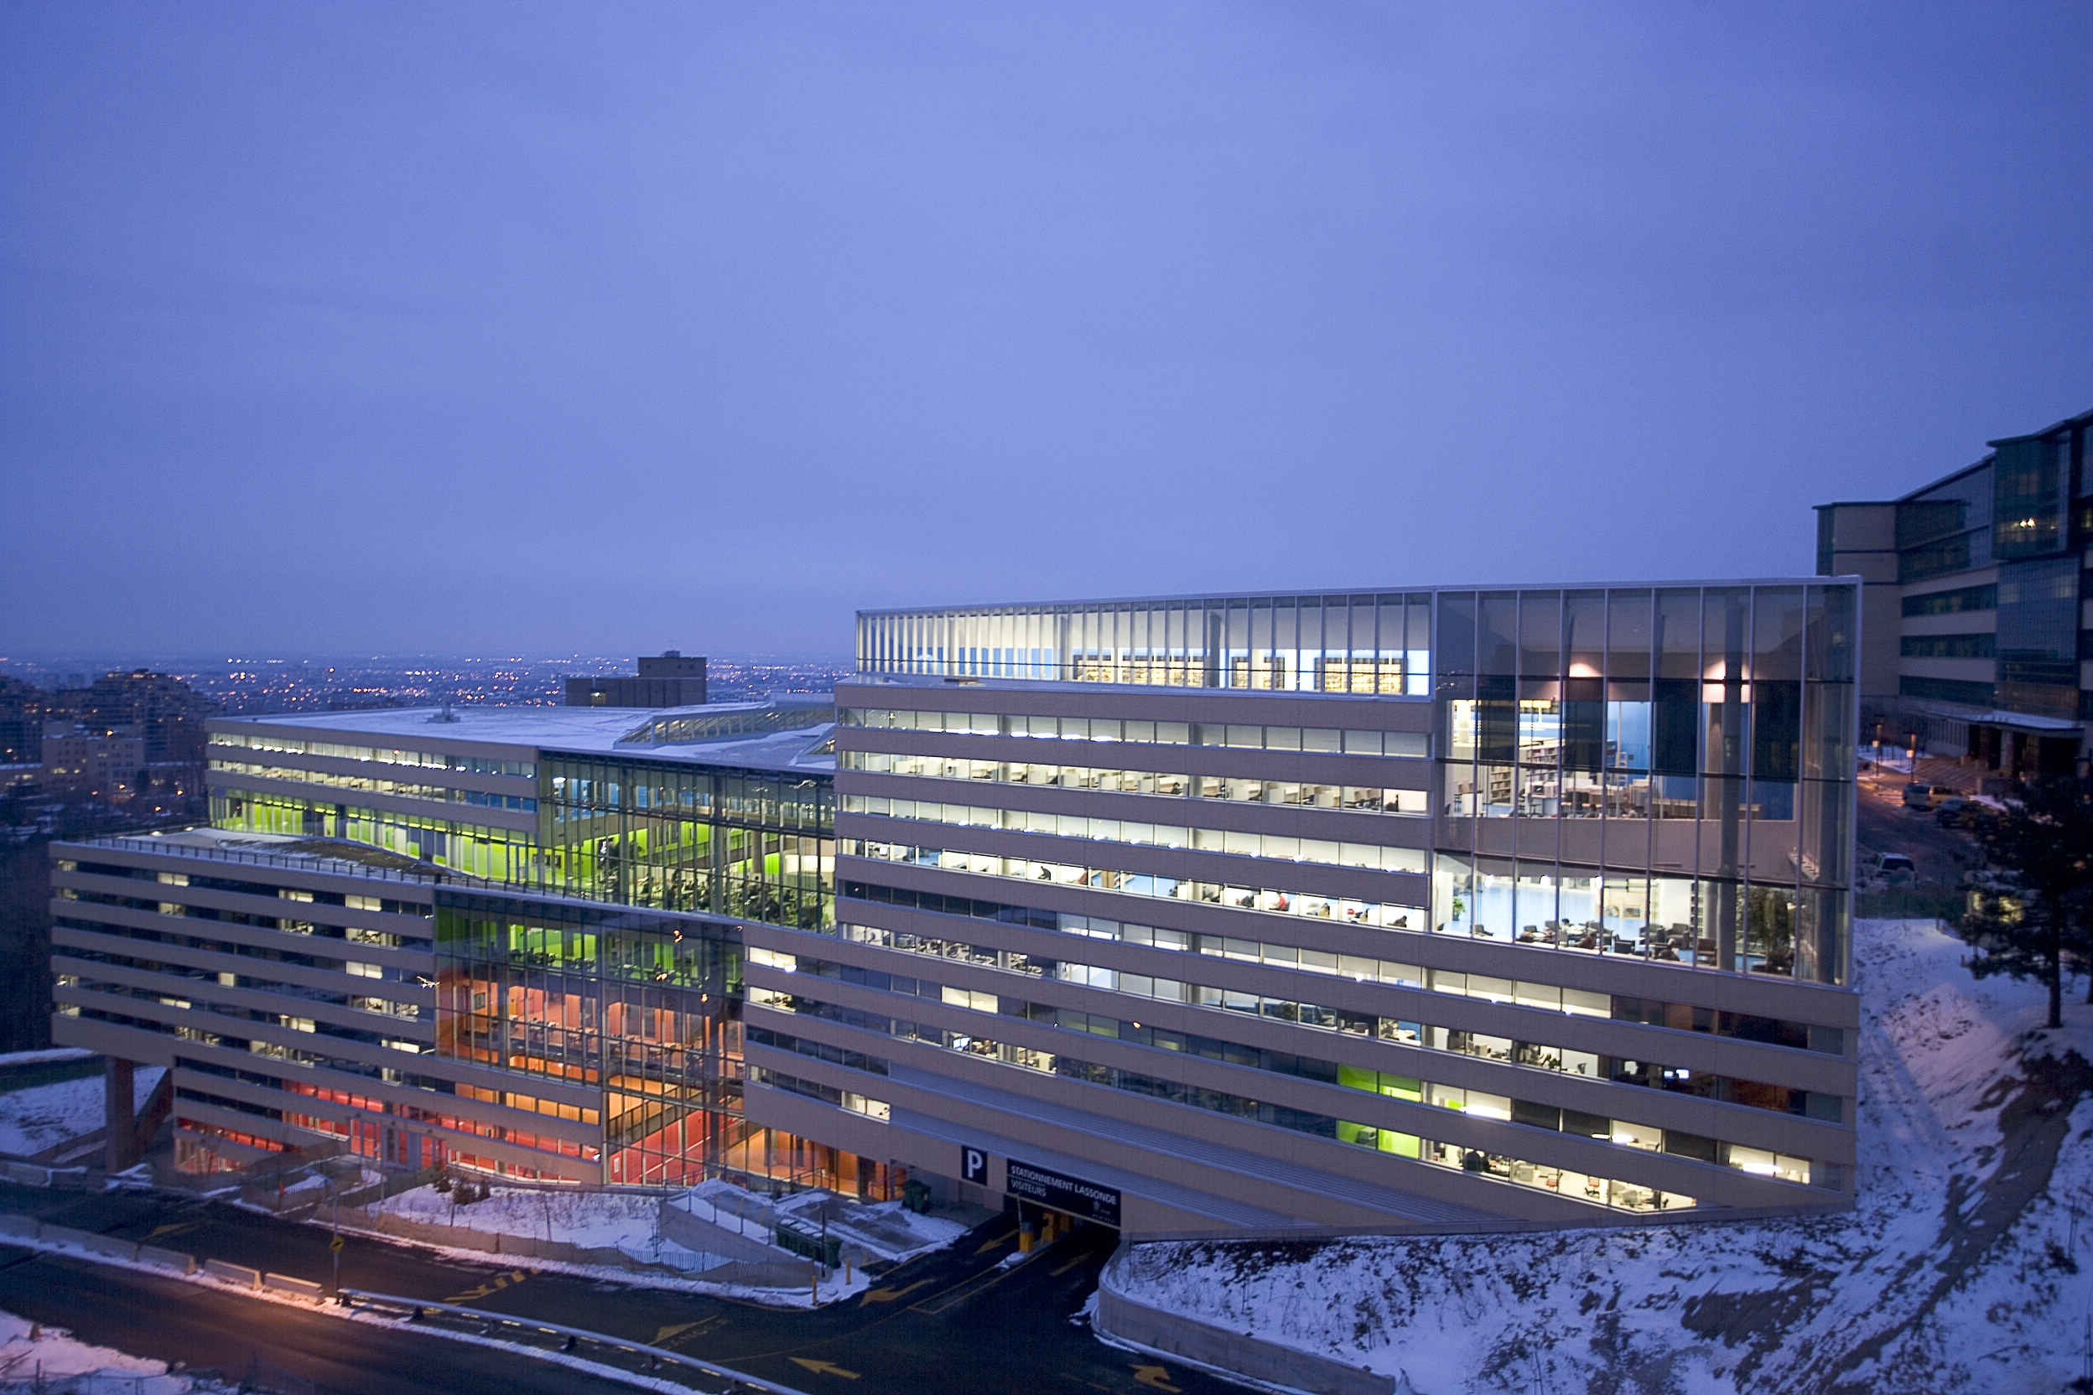
IND8115 – LTTng Web View
December, 12th 2016
Yonni Chen

Slide 2
Main technologies
Web server base on Laravel’s framework
Client side using Angular 2
ChartJS for the visualization
D3 for flamegraph chart

Slide 3
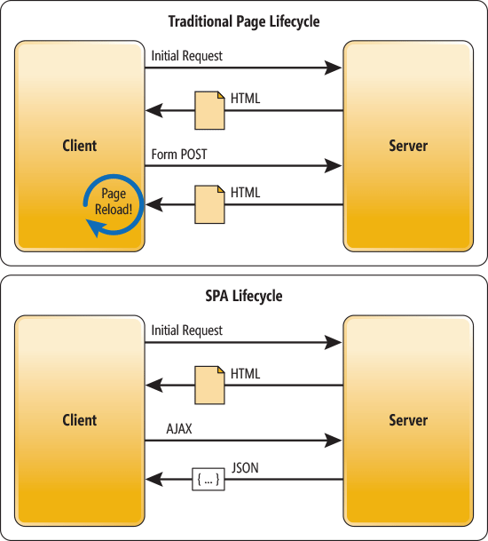
Architecture
Problems
Loading the DOM is heavy
Some part of the UI must be reusable.
Need a low impact on the network trafic
Solutions
Single Page Application
DOM is loaded once. Component are updated via AJAX queries

Slide 4
Architecture
Dashboard Component
Navigation Component
Gridstack Component
Grid-item
Component
Grid-item
Component
Grid-item
Component
Grid-item
Component

Slide 5
Architecture
Previous component are here only for the layout
Injecting services to components to retrieve data;
Services send an HTTP request to a REST API endpoint
Using a child component for visualization library;
Reducing network load
Using Gulp for minifying and uglifying CSS and JS files
POST request with body object;
JSON compression

Slide 6
Parser architecture
Metadata file
LTTng parser
produces
Intermediate data model
take
Data file
use
Needed by
Chart generator
Chart
Chart
Chart
Chart
Chart

Slide 7
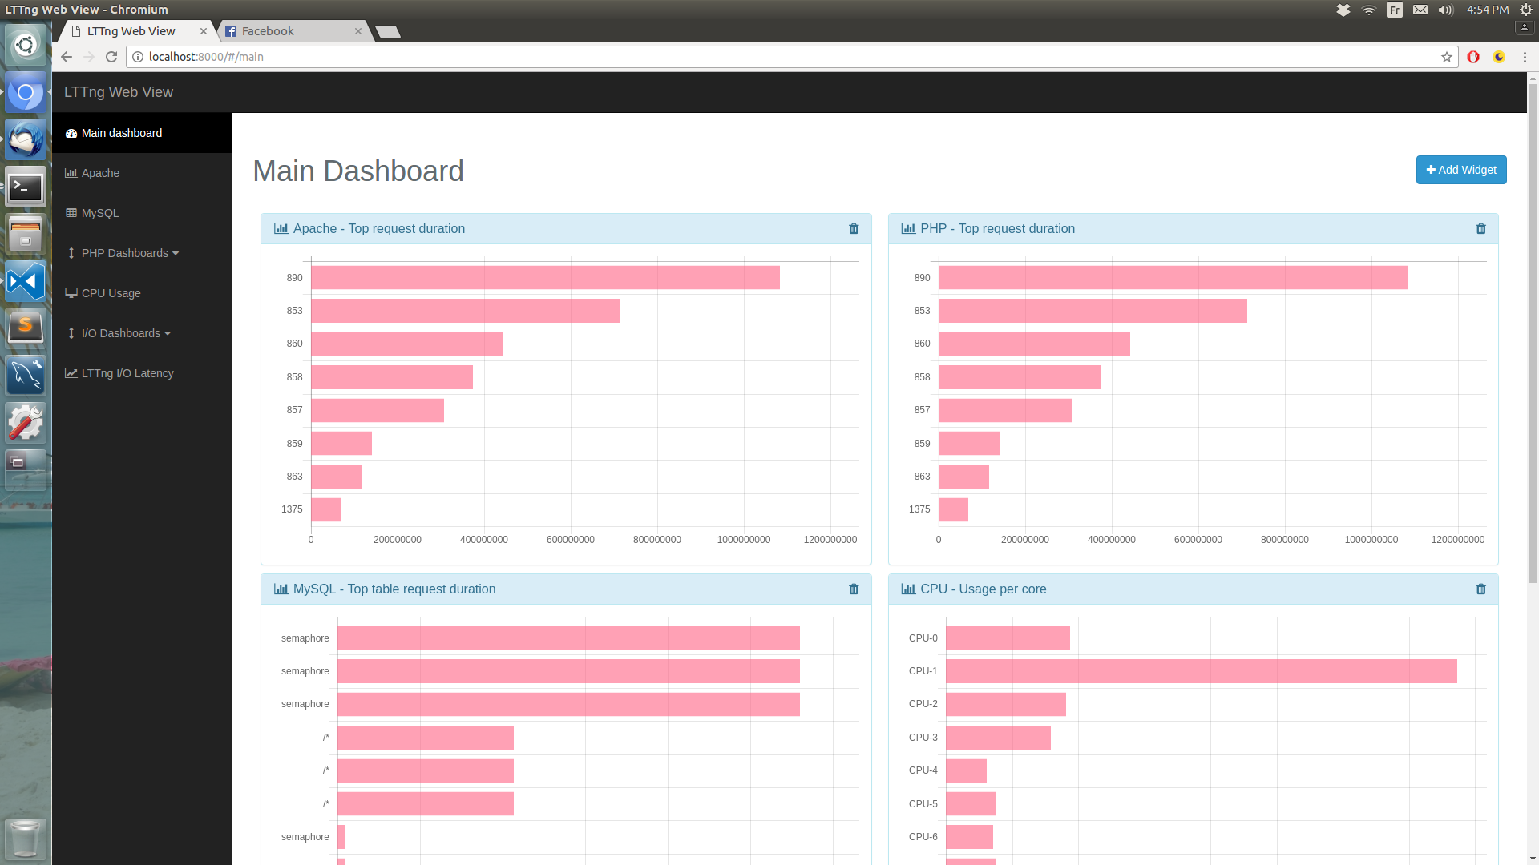
Some screenshot

Slide 8
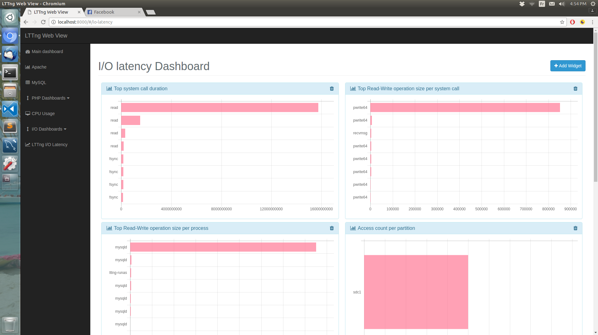
Some screenshot

Slide 9
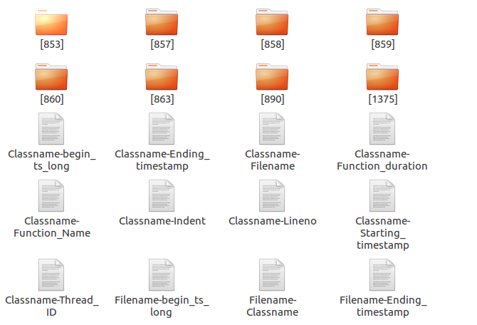
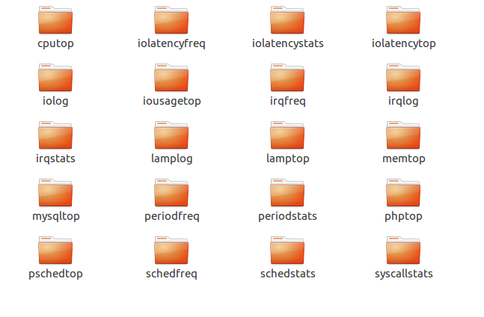
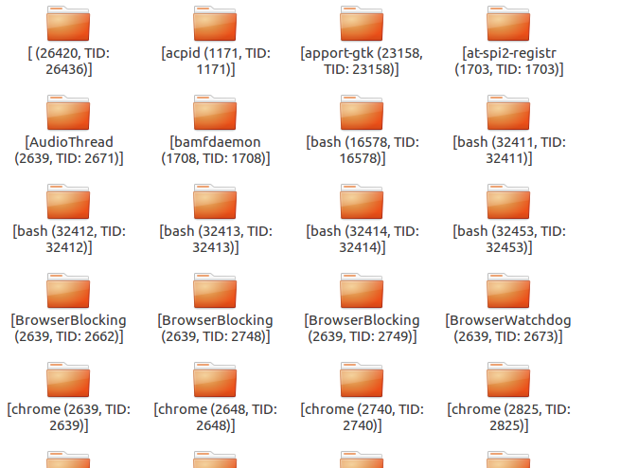
The possibilities

Slide 10
For the future
Use dependency injection for the visualization library
It must be easy to change the visualization in case that library is not supported anymore
It provides more modularity and customization
Nanoseconds timeline visualization support
JavaScript is limitating. We can’t be more precise that milliseconds!
PHP parser will have a performance issue
Files larger that 150-200 MB;
What about 1 GB trace file?
Rewriting the parser in C++ 11
Using RapidJSON

Slide 11
Questions

